Slide 1
WP 3
Training and integration the training program in teaching system MediTec team 22nd – 24th February 2018, Amman, Jordan

Slide 2
WP 3 - Related assumptions and risks
Assumptions
Support from management in partner universities and ministries of health and high educations in JO, IR and IQ
Support from EU partners
High experience in medical vocational training on innovative and advanced medical technology at EU partners
Risks
Resistance scepticism in partner universities staff
Low inflow of innovative technology for teachers, staff and students and doctors
Restricted availability of staff members for training at the EU - will be solved using substitutions
Insufficient language skills of partner countries university staff - will be solved using translation services when needed

Slide 3
WP 3 - Description
Training of students and staff of project implementation units will be organized in EU partners during the 2nd and the 3rd year of project life.
Mobility’s from JO, IR and IQ to EU are planned to implement the deliverable. EU partners will conduct trainings on methodical aspects of modernizing training programs and materials. EU partners will support training sessions with presentation of practical applications.
Axes required to achieve the result WP 3
Development of training programs on innovative medical technology
Development of training materials to use in training
Sessions held with the teachers at partner universities in the areas of overall efficiency that meets the needs of the staff, doctors and students
Training workshops in the field of innovative technology in medicine

Slide 4
WP 3 - Description
Activities to achieve result WP 3 axes
Training for students and staff members and students in partner’s universities will be conducted
Skills workshops in all partner countries
Training workshops at each partner universities in JO, IR and IQ
Development of multimedia approach for modernized training
Training materials will be developed
Enhancing the competences of teachers in using innovative technology for training

Slide 5
WP 3 - Tasks
Tasks
3.1 Studying of EU experience by mobility of staff and students
3.2 Develop training programs for the training on innovative medical technology
3.3 Improvement of training methodical complexes on base of modernized training and Training of instructors
3.4 Integration the medical training program in study programs at the universities
3.5 Development of multimedia approach and manuals for modernized training
Estimated Start Date: 15-11-2018
Estimated End Date: 15-10-2020
Lead Organisation: EU Partners, all Local Coordinators
Participating Organisation: All partners

Slide 6
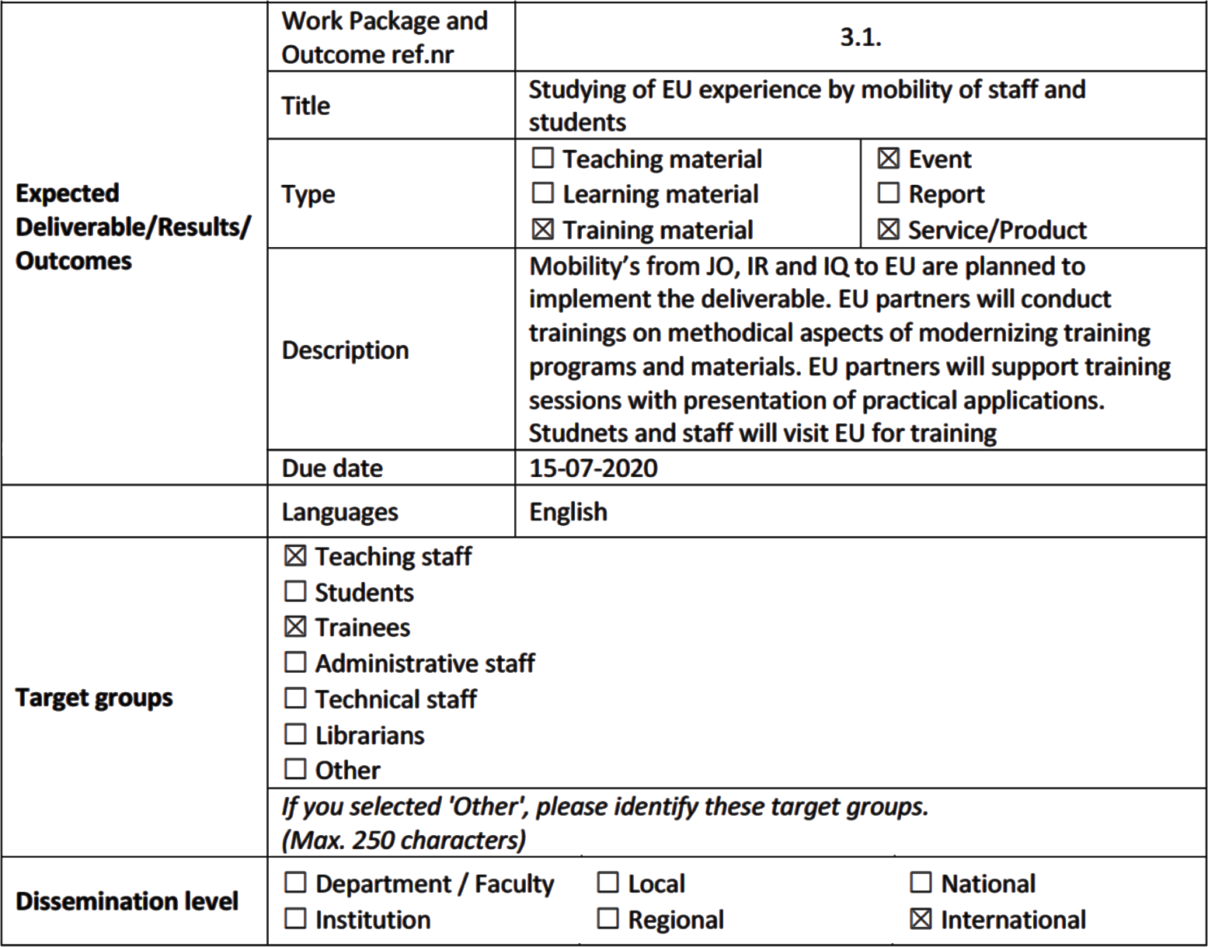
WP 3 - 3.1 Studying of EU experience by mobility of staff and students

Slide 7
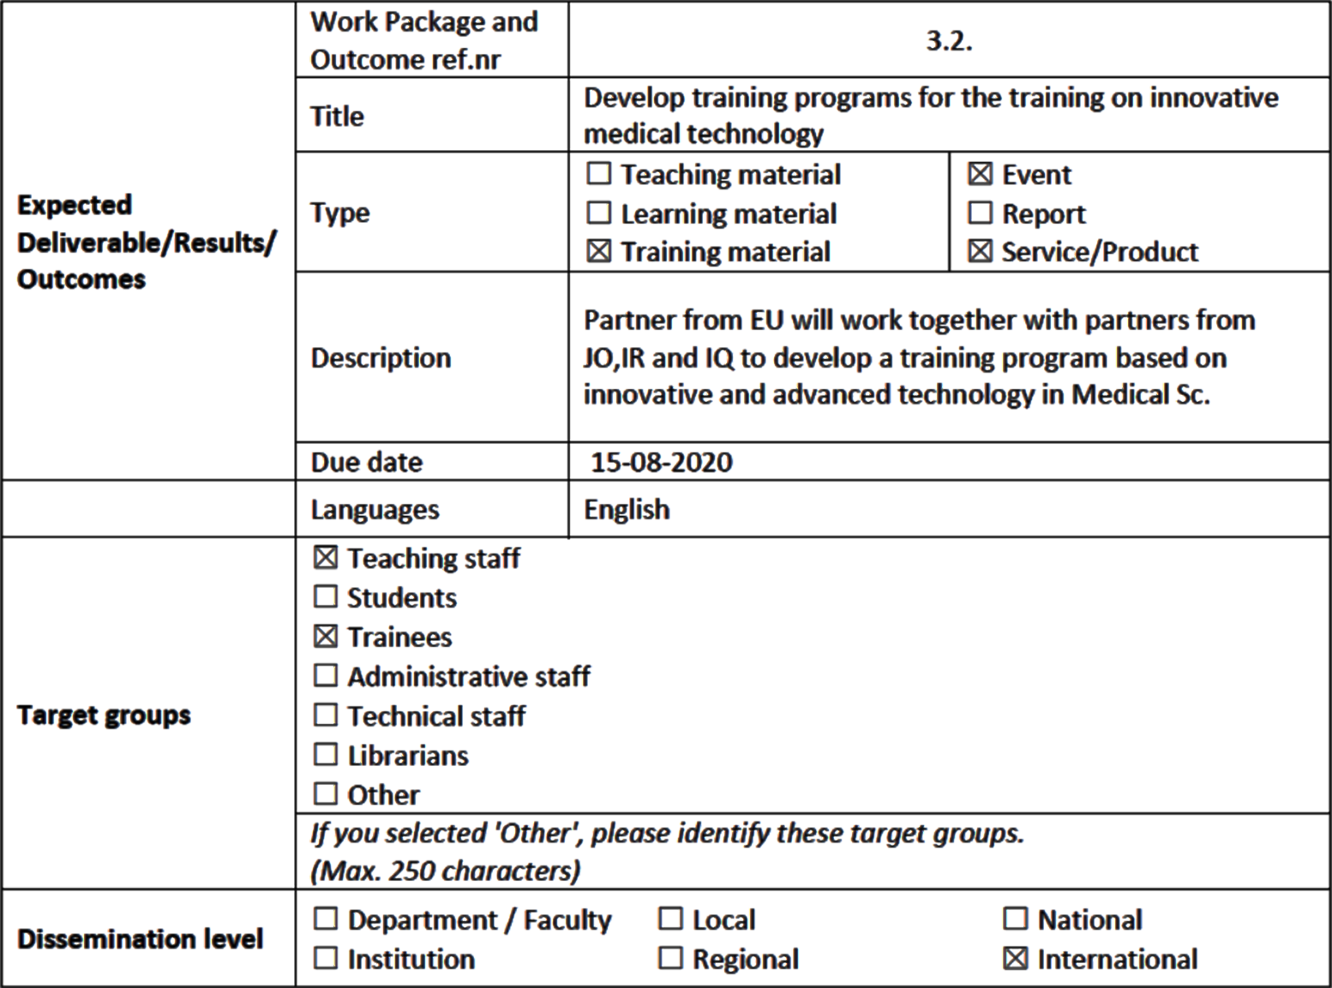
WP 3 - 3.2 Develop training programs for the training on innovative medical technology

Slide 8
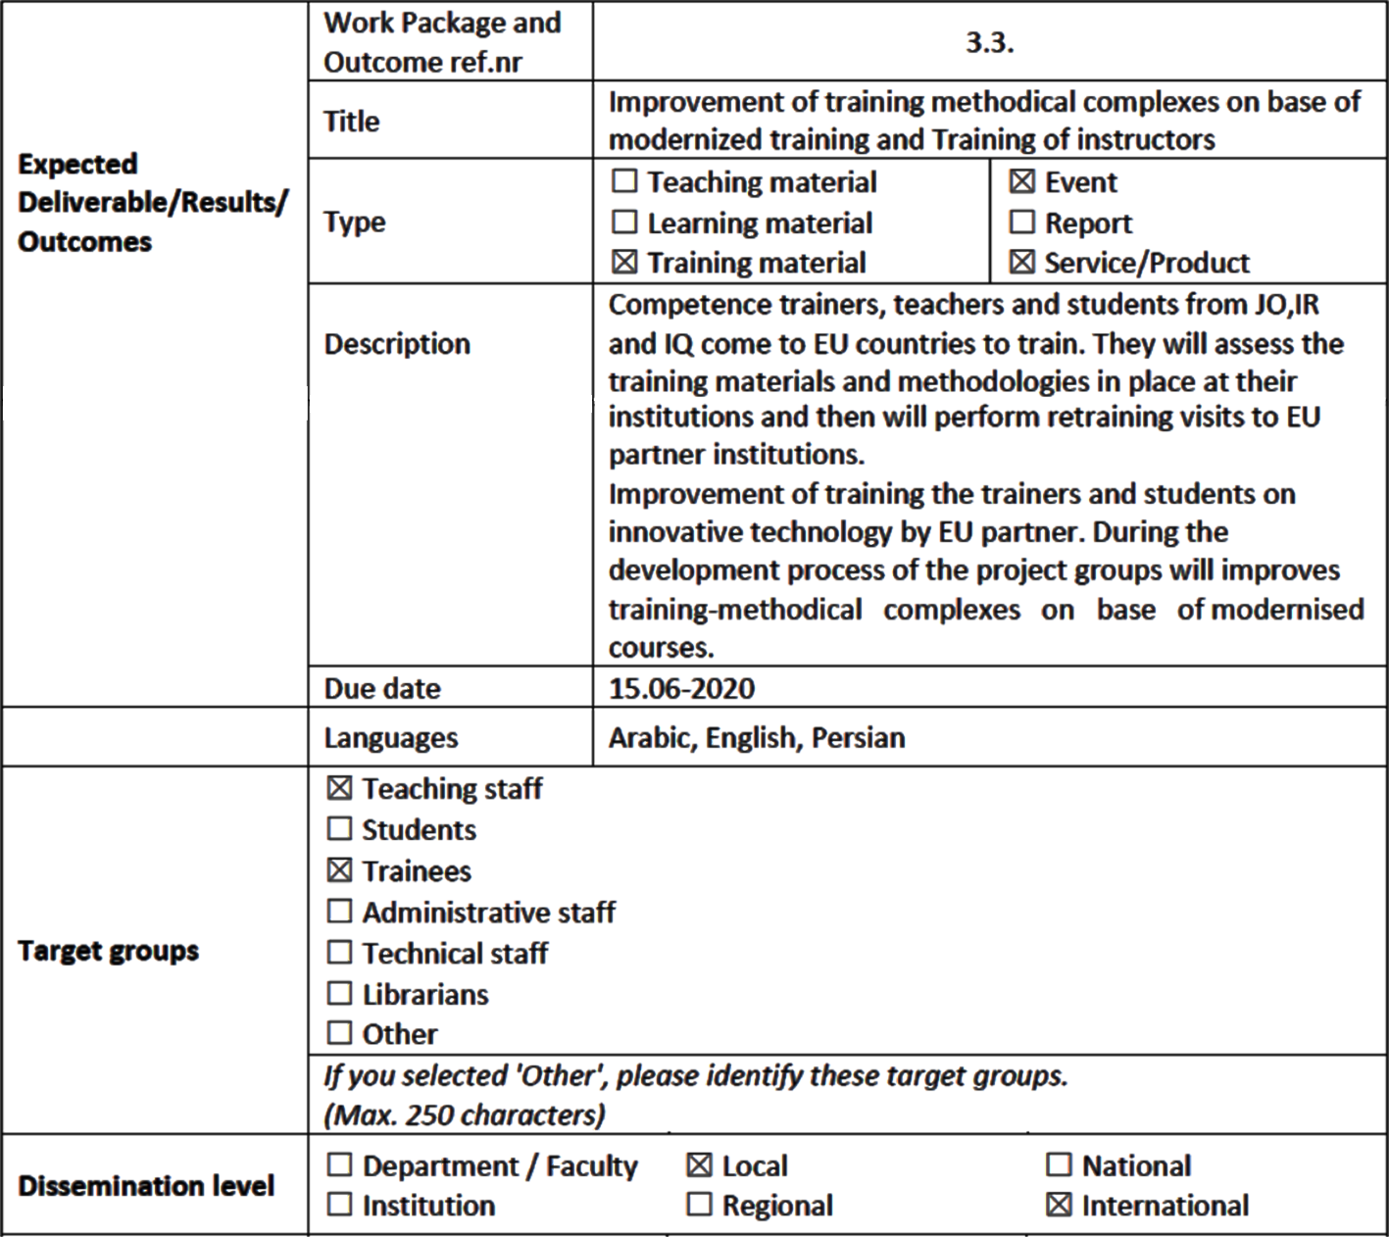
WP 3 - 3.3 Improvement of training methodical complexes on base of modernized training and Training of instructors

Slide 9
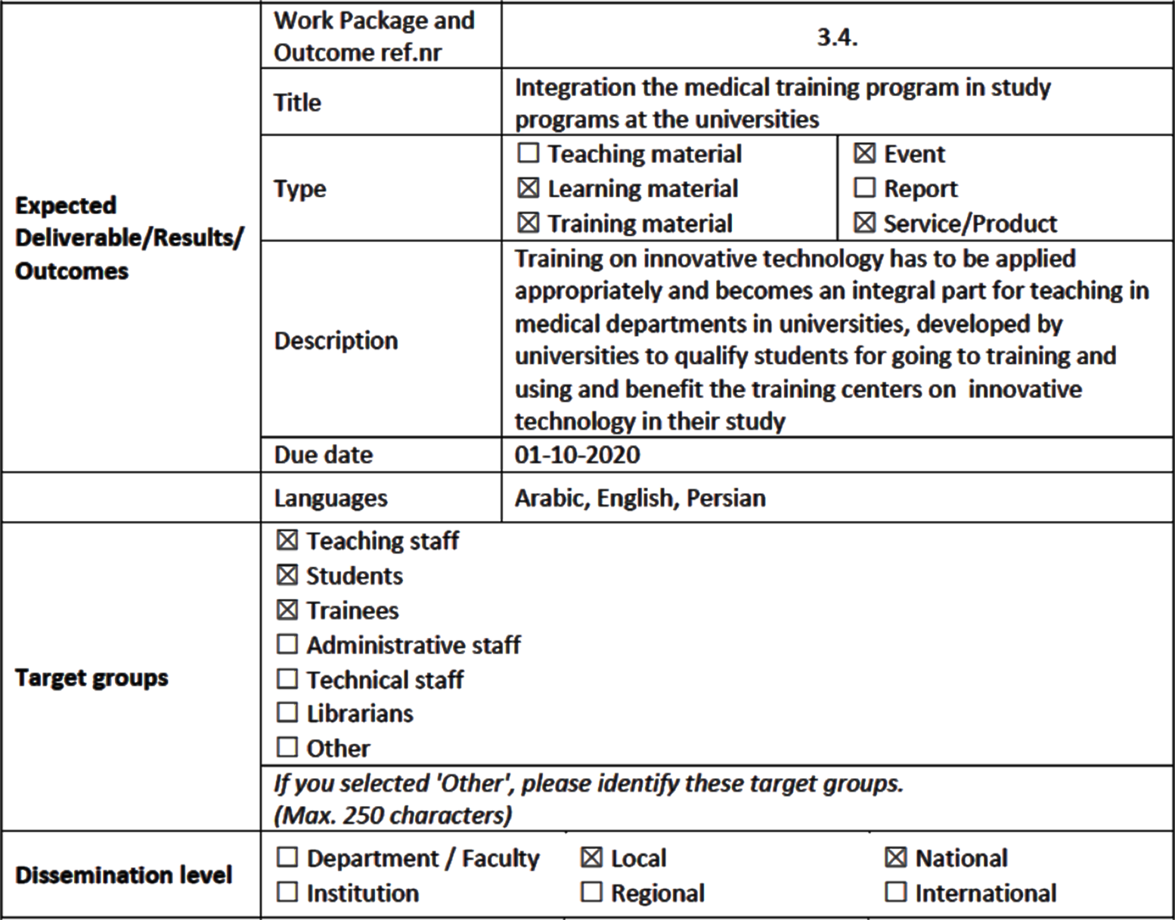
WP 3 - 3.4 Integration the medical training program in study programs at the universities

Slide 10
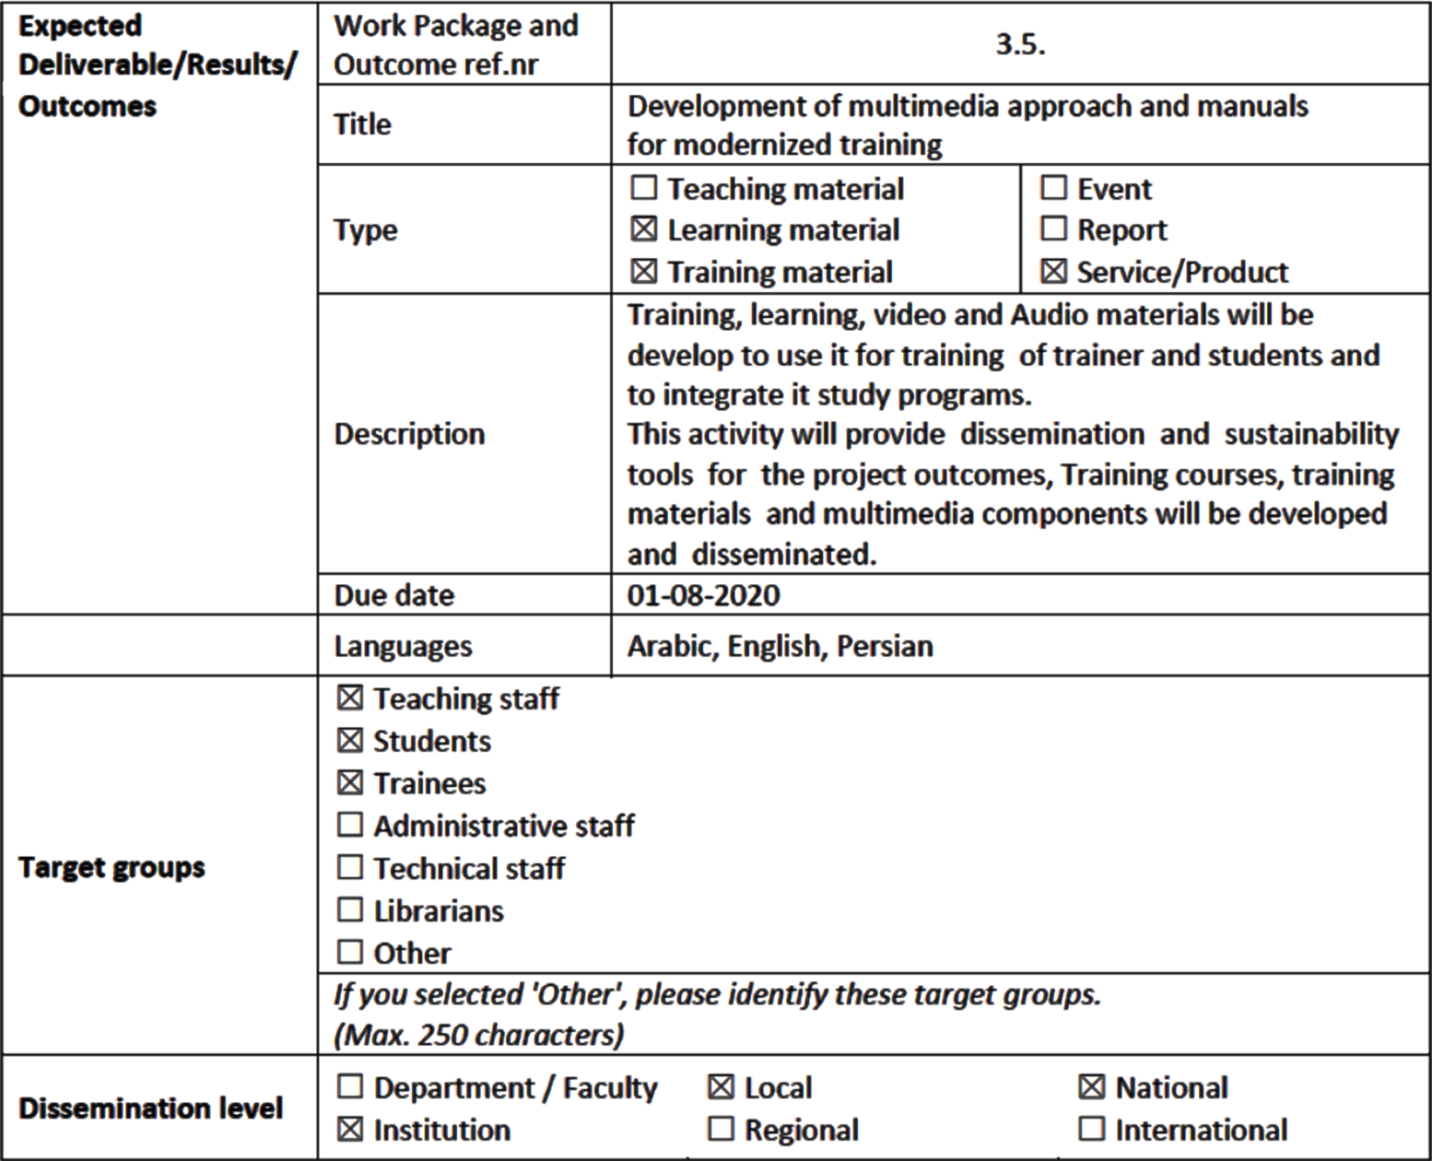
WP 3 - 3.5 Development of multimedia approach and manuals for modernized training

Slide 11
Thanks for your attention

